Slide 1
Partial Orders
Jorge A. Cobb
The University of Texas at Dallas

Slide 2
Partially ordered sets
Partial orders (relations that are reflexive, antisymmetric, and transitive) can be used to order the elements of a set
Equivalence relations, on the other hand, break a set into pieces (subsets) of “same” or equal elements (equiv. classes)
A set S together with a partial order R is called a partially ordered set or poset (S, R).

Slide 3
Example posets
The set of reals with “≤”
The set of positive integers with “|” (divides)
The power set of a set with “⊆”
The set of English words with “lexicographic order” on strings
  compare successive letters until a different one is found – order of these letters determines the order of strings

Slide 4
More examples
Is “<“ and the reals a PoSet?
Consider set S = {all people}, R = {(x,y) | (x is older than y}. Is R a partial order (and (S,R) a PoSet?)
  R is antisymmetric (if I am older than you you can’t be older than me)
  R is transitive
  R is not reflexive though.

Slide 5
Comparable elements
Let ≼ be a partial order on a set S.
Elements x ∈ S and y ∈ S are called comparable if x ≼ y or y ≼ x.
Otherwise, x and y are called incomparable.
Note also that if x is comparable with y, then y is comparable with x

Slide 6
a is comparable with n, m, r and s
x is comparable with m, r, and s
s is comparable with r, m, a, and x
a and x are NOT comparable
m and n are NOT comparable
n and x are not comparable
s
r
m
n
x
a
Let R be the reflexive and transitive closure of this graph (R is thus a partial order)

Slide 7
Total order (linear order)
A partial order ≼ on a set S is called a total order or a linear order if any two elements are comparable. In that case, the set S is called a totally ordered or linearly ordered set, or a chain.

Slide 8
All elements are comparable with each other
(transitive edges are removed for ease of drawing)

Slide 9
Examples
Is ≤ on the set of reals a total order?
  Yes. For any reals x and y, either x ≤ y or y ≤ x.
| on the set of positive integers?
  No. Neither 2 divides 3, nor 3 divides 2.
⊆ on the power set of a set?
  No. For x ≠ y, neither {x} ⊆ {y}, nor {y} ⊆ {x}.
Lexicographic order on English words?
  Yes. For any two words, either x precedes y or y precedes x (or both if they are the same).

Slide 10
Well-Founded Sets
A total order (S, R) is well founded iff all non-empty subsets of S have a “least” element
  i.e., if S’ ⊆ S ≠ ∅, then
  there must exist an x ∈ S’ such that for all y ∈ S’
  x R y
x

Slide 11
Examples
Is the set of positive integers Z⁺ well founded under ≤ ?
  Yes
Is the set of negative integers Z⁻ well founded under ≤ ?
  No, why?
Is the set of all integers Z well founded under ≤?
  No, why?

Slide 12
Well Founded Induction
Let (S, ≼) be a well-founded set, P(x) is true if
  for all y ∈ S,
  if (for all x, x ≺ y, P(x) is true)
  then P(y) is true
Normal induction uses the non-negative integers and ≤ as a well-ordered set
What about the base case?

Slide 13
Generalized lexicographic order
If (A₁, ≼₁), (A₂, ≼₂), ..., (A_{n}, ≼_{n}) are posets, the lexicographic order on the Cartesian product A₁ × A₂ × ... × A_{n} is defined recursively:
(a₁, a₂, ..., a_{n}) ≼ (b₁, b₂, ..., b_{n}) if
  a₁ ≼₁ b₁ and a₁ ≠ b₁ , or
  a₁ = b₁ and (a₂, ..., a_{n}) ≼ (b₂, ..., b_{n})
Note that “regular” lexicographic order
  is a special case where the A_{i}’s are the same (set of letters) and the ≼_{i}’s are simply alphabetical order
Is a GLO a partial order?

Slide 14
Example
Consider A = Z⁺, B = {a, b, c, …, z}, what are all the elements of A x B such that they are lexicographically ≤ (3, c)?
Answer
  (1, a) … (1, z),
  (2, a) … (2, z),
  (3, a), (3, b), (3, c)

Slide 15
Lexicographic order on strings
If x = (x₁, x₂, ..., x_{n}) and y = (y₁, y₂, ..., y_{m}) are two strings, we define lexicographic order on them as an extension of the previous that takes care of different lengths.
Let k = min(n, m); then x ≼ y iff
  (x₁, x₂, ..., x_{k}) ≼ (y₁, y₂, ..., y_{k})
Note that:
  If x and y have the same length, then it is as before
  If different length, then
    If the first k values are the same, then the shorter string is ≼ to the larger string
    If some of the first k values are different, then the first k values determine the order.

Slide 16
Lexicographic order on strings
discreet ≼ discrete
  Same length, but e < t
discreet ≼ discreetness
  First one is shorter and a prefix of the other
discreet ≼ discretion
  First one is shorter but not a prefix and e < t.

Slide 17
Hasse diagrams
What is the directed graph representation of a partial order?
  There will be loops at every node
  Transitivity will produce many “extra” edges
  There will be a particular direction for edges
Hasse diagrams simplify the graph by removing loops, removing extra edges implied by transitivity, and putting nodes in their order (bottom to top) so that arrows can be omitted

Slide 18
Example Hasse diagram
“≤” on {1, 2, 3, 4}
4
4
4
4
3
3
3
3
2
2
2
2
1
1
1
1

Slide 19
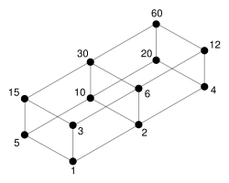
More Hasse diagram examples
“divides” on {1, 2, 3, 4, 5, 6, 10, 12, 15, 20, 30, 60} (all divisors of 60)

Slide 20
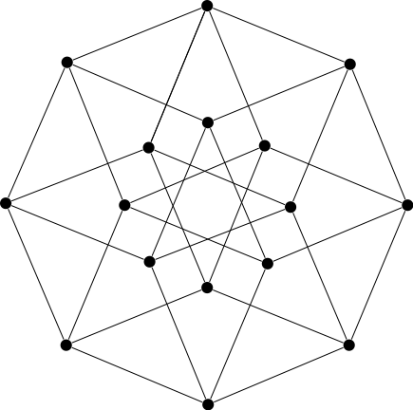
More Hasse diagram examples
“⊆” on the power set of {a, b, c, d}

Slide 21
Maximal and minimal elements
An element x of a poset (S, ≼) is called
  minimal, if there is no other element that precedes it, i.e., there is no y ∈ S such that y ≺ x
  maximal, if there is no other element that follows it, i.e., there is no y ∈ S such that x ≺ y
Existence
  Guaranteed for finite sets
Uniqueness
  Generally not unique

Slide 22
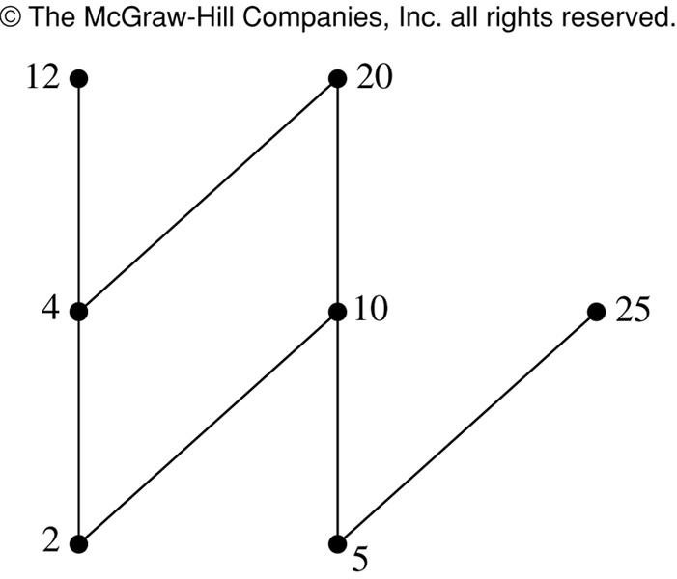
Note: the minimal and maximal elements here are not unique

Slide 23
Greatest and least elements
An element x of a poset (S, ≼) is called
  least, if it is less than all other elements, i.e., for all y ∈ S, x ≼ y
  greatest, if it is greater than all other elements, i.e., for all y ∈ S, y ≼ x
Existence
  Not guaranteed
Uniqueness
  Unique if it exists

Slide 24
There is no greatest element
1 (is least)

Slide 25
More examples
The power set of a set S with set inclusion
  ∅ is least and minimal, because it is a subset of every other set
  S is greatest and maximal, because it is a superset of every other set
The set of positive integers with “divides”
  1 is least and minimal
  There is no maximal element (and hence also no greatest element), because the set is infinite in the “up” direction.

Slide 26
Upper and lower bounds
Given a poset (S, ≼) and a subset B of S, an element x ∈ S is an upper bound of B if y ≼ x for all y ∈ B (note that x may not be in B)
Lower bound defined as above by changing “y ≼ x” to “x ≼ y”.
An upper bound is a least upper bound if it is less than all other upper bounds; similarly we get a greatest lower bound.
These are unique if they exist.

Slide 27
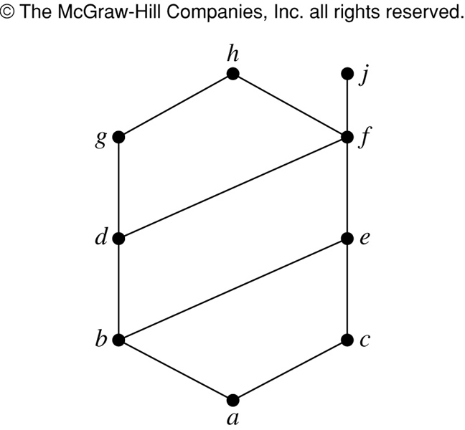
Upper bounds of {a,b,c}:
  e, f, j, and h
Lower bounds of {a,b,c}:
  only a
Upper bounds of {j,h}:
  none
Lower bounds of {j,h}:
  all others except g
Upper bounds of {a,c,d,f}:
  f, h, j
Lower bounds of {a,c,d,f}:
  only a

Slide 28
Least upper bound of {b,d,g}:
  Upper bounds are g and h
  Least upper bound is g (g ≼ h)
Greatest lower bound of {b.d.g}:
  Lower bounds are a and b
  Greatest lower bound is b (a ≼ b)

Slide 29
Lattices
A special case of partially ordered sets (S, ≼) with the property that for any pair {x, y} with x, y ∈ S, there is a least upper bound and a greatest lower bound.
Lattices have important properties that make them suitable for modeling
  information flow
  statistical dependency models

Slide 30
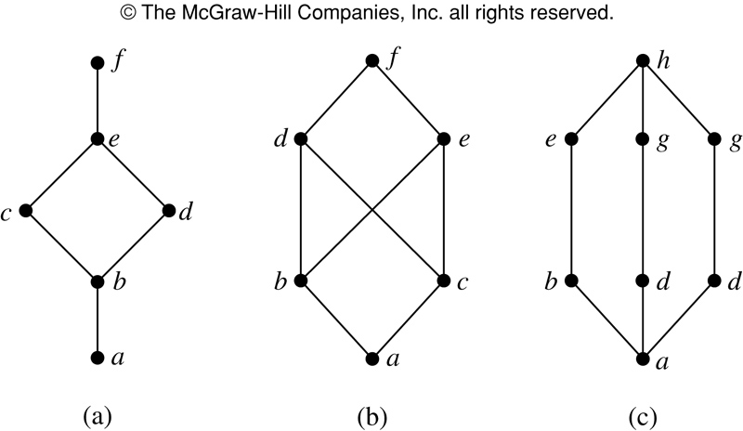
Which of these are lattices???
f
c
Consider the pair b and c.
What are their upper bounds?
What is the least upper bound?

Slide 31
Example lattices
Power set of a set with set inclusion (P(S),⊆)
  Let A and B be subsets of S.
  least upper bound of {A, B}: A ∪ B
  greatest lower bound of {A, B}: A ∩ B
The set of positive integers with “divides”
  least upper bound of {n, m}: the least common multiple of n and m
  greatest lower bound of {n, m}: the greatest common divisor of n and m

Slide 32
Final example of lattice
Are ({1,2,3,4,5}, |) and ({1,2,4,8,16}, |) lattices?
{1,2,3,4,5}
  Consider the upper and lower bounds of {2, 3}.
{1,2,4,8,16}
  For any pair, the smallest of the pair is the greatest lower bound
  For any pair, the largest is the least upper bound.

Slide 33
Topological sorting
The task of constructing a compatible total order S out of a partial order R
  “compatible” means x S y whenever x R y
Also called linearization of R
Practical application:
  Task dependencies are modeled with a relation R between tasks such that x R y iff task x must be completed before task y can start. Then a linearization of R is a possible order for doing the tasks.

Slide 34
Algorithm for topological sorting
Let A = S
Loop until no elements left
  Find a minimal element x of A (always exists for a finite set)
  x is next in the total order
  Replace A with A – {x}
  Replace ≼ with ≼ – (({x} × A) ∪ (A × {x}))
Complexity
  O(n) iterations, each costs O(n) to find the minimal element, O(n) for each of the bookkeeping steps. Total O(n²).

Slide 35
Topological sort for
({1, 2, 4, 5, 8, 12}, “|”)
Minimal element: 1
Minimal element: 2 or 5; let’s choose 5.
Minimal element: 2
Minimal element: 4
Minimal element: 8 or 12; let’s choose 8.
Minimal element: Only 12 left.
Output: 1 ≺ 5 ≺ 2 ≺ 4 ≺ 8 ≺ 12.

Slide 36
